Slide 1
Desing Patterns

Slide 2



Hello!
Parsa Abbasi
parsa.abassi1996@gmail.com
https://www.linkedin.com/in/parsa-abbasi/
Mehran Rafiee
mehranrafiee5@gmail.com
https://www.linkedin.com/in/mehranrafiee97/

Slide 3

Pattern
"Each pattern describes a problem which occurs over and over again in our environment, and then describes the core of the solution to that problem, in such a way that you can use this solution a million times over, without ever doing it the same way twice"
Christopher Alexander (Real-world Architect)
Image attribution: wikipedia.org
Notes:
In software engineering, a design pattern is a general repeatable solution to a commonly occurring problem in software design. A design pattern isn't a finished design that can be transformed directly into code. It is a description or template for how to solve a problem that can be used in many different situations.
Design patterns represent the best practices used by experienced object-oriented software developers. Design patterns are solutions to general problems that software developers faced during software development. These solutions were obtained by trial and error by numerous software developers over quite a
Design Patterns are formalized best practices used to solve the most common problems that generally occur during OOP Software Development substantial period of time.

Slide 4
Design Patterns
In general
A pattern has four essential elements:
Pattern name
Problem
Solution
Consequences
Notes:
The pattern name is a handle we can use to describe a design problem, its solutions, and consequences in a word or two. Naming a pattern immediately increases our design vocabulary. It lets us design at a higher level of abstraction. Having a vocabulary for patterns lets us talk about them with our colleagues, in our documentation, and even to ourselves. It makes it easier to think about designs and to communicate them and their trade-offs to others. Finding good names has been one of the hardest parts of developing our catalog.
The problem describes when to apply the pattern. It explains the problem and its context. It might describe specific design problems such as how to represent algorithms as objects. It might describe class or object structures that are symptomatic of an inflexible design. Sometimes the problem will include a list of conditions that must be met before it makes sense to apply the pattern.
The solution describes the elements that make up the design, their relationships, responsibilities, and collaborations. The solution doesn't describe a particular concrete design or implementation, because a pattern is like a template that can be applied in many different situations. Instead, the pattern provides an abstract description of a design problem and how a general arrangement of elements (classes and objects in our case) solves it.
The consequences are the results and trade-offs of applying the pattern. Though consequences are often unvoiced when we describe design decisions, they are critical for evaluating design alternatives and for understanding the costs and benefits of applying the pattern. The consequences for software often concern space and time trade-offs. They may address language and implementation issues as well. Since reuse is often a factor in object-oriented design, the consequences of a pattern include its impact on a system's flexibility, extensibility, or portability. Listing these consequences explicitly helps you understand and evaluate them.

Slide 5
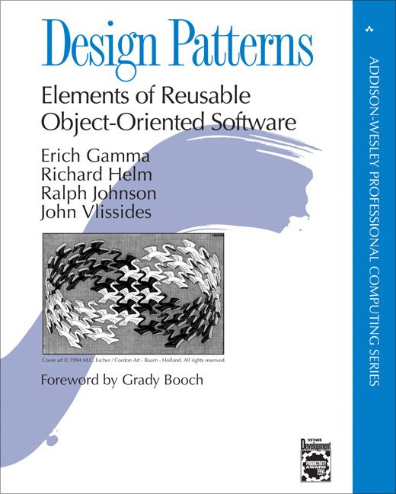


Design Patterns
In software engineering
Are not about designs such as linked lists and hash tables that can be encoded in classes and reused as is.
Are descriptions of communicating objects and classes that are customized to solve a general design problem in a particular context.
Image attribution: blog.agileactors.com
Notes:
Point of view affects one's interpretation of what is and isn't a pattern. One person's pattern can be another person's primitive building block. For this book we have concentrated on patterns at a certain level of abstraction. Design patterns are not about designs such as linked lists and hash tables that can be encoded in classes and reused as is. Nor are they complex, domain-specific designs for an entire application or subsystem. The design patterns in this book are descriptions of communicating objects and classes that are customized to solve a general design problem in a particular context.

Slide 6
In software engineering, a design pattern is a general repeatable solution to a commonly occurring problem in software design.
Notes:
In software engineering, a design pattern is a general repeatable solution to a commonly occurring problem in software design. A design pattern isn't a finished design that can be transformed directly into code. It is a description or template for how to solve a problem that can be used in many different situations.
Design patterns represent the best practices used by experienced object-oriented software developers. Design patterns are solutions to general problems that software developers faced during software development. These solutions were obtained by trial and error by numerous software developers over quite a
Design Patterns are formalized best practices used to solve the most common problems that generally occur during OOP Software Development substantial period of time.

Slide 7
Types of Patterns
We classify design patterns by two criteria :
The first criterion, called purpose, reflects what a pattern does.
The second criterion, called scope, specifies whether the pattern applies primarily to classes or to objects.

Slide 8
Types of Patterns: Based on purpose
Creational
Creational patterns concern the process of object creation
Deal with initializing and configuring classes and objects
Structural
Structural patterns deal with the composition of classes or objects.
Behavioral
Behavioral patterns characterize the ways in which classes or objects interact and distribute responsibility.
Notes:
The first criterion, called purpose, reflects what a pattern does. Patterns can have either creational,structural, orbehavioral purpose. Creational patterns concern the process of object creation. Structural patterns deal with the composition of classes or objects. Behavioral patterns characterize the ways in which classes or objects interact and distribute responsibility.

Slide 9
Types of Patterns: Based on scope
Class
Class patterns deal with relationships between classes and their subclasses.
These relationships are established through inheritance, so they are static— fixed at compile-time.
Object
Object patterns deal with object relationships, which can be changed at run-time and are more dynamic.
Notes:
The second criterion, called scope, specifies whether the pattern applies primarily to classes or to objects. Class patterns deal with relationships between classes and their subclasses. These relationships are established through inheritance, so they are static— fixed at compile-time. Object patterns deal with object relationships, which can be changed at run-time and are more dynamic. Almost all patterns use inheritance to some extent. So the only patterns labeled "class patterns" are those that focus on class relationships. Note that most patterns are in the Object scope.

Slide 10
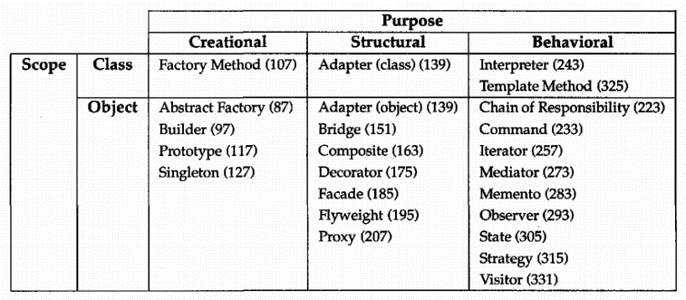
Types of Patterns
Table attribution: “Design Patterns: Elements of Reusable Object-Oriented Software” by GoF
Notes:
Creational class patterns defer some part of object creation to subclasses, while Creational object patterns defer it to another object. The Structural class patterns use inheritance to compose classes, while the Structural object patterns describe ways to assemble objects. The Behavioral class patterns use inheritance to describe algorithms and flow of control, whereas the Behavioral object patterns describe how a group of objects cooperate to perform a task that no single object can carry out alone.

Slide 11

The Catalog of Design Patterns
Creational
Factory Method
Define an interface for creating an object, but let subclasses decide which class to instantiate. Factory Method lets a class defer instantiation to subclasses.
Abstract Factory
Provide an interface for creating families of related or dependent objects without specifying their concrete classes.
Builder
Separate the construction of a complex object from its representation so that the same construction process can create different representations.

Slide 12
The Catalog of Design Patterns
Creational
Prototype
Specify the kinds of objects to create using a prototypical instance, and create new objects by copying this prototype.
Singleton
Ensure a class only has one instance, and provide a global point of access to it.

Slide 13
The Catalog of Design Patterns
Structural
Adapter
Convert the interface of a class into another interface clients expect. Adapter lets classes work together that couldn't otherwise because of incompatible interfaces.
Bridge
Decouple an abstraction from its implementation so that the two can vary independently.
Composite
Compose objects into tree structures to represent part-whole hierarchies. Composite lets clients treat individual objects and compositions of objects uniformly.

Slide 14
The Catalog of Design Patterns
Structural
Decorator
Attach additional responsibilities to an object dynamically. Decorators provide a flexible alternative to subclassing for extending functionality.
Facade
Provide a unified interface to a set of interfaces in a subsystem. Facade defines a higher-level interface that makes the subsystem easier to use.
Flyweight
Use sharing to support large numbers of fine-grained objects efficiently.

Slide 15
The Catalog of Design Patterns
Structural
Proxy
Provide a surrogate or placeholder for another object to control access to it.

Slide 16
The Catalog of Design Patterns
Behavioral
Interpreter
Given a language, define a representation for its grammar along with an interpreter that uses the representation to interpret sentences in the language.
Template Method
Define the skeleton of an algorithm in an operation, deferring some steps to subclasses. Template Method lets subclasses redefine certain steps of an algorithm without changing the algorithm's structure.
Chain of Responsibility
Avoid coupling the sender of a request to its receiver by giving more than one object a chance to handle the request. Chain the receiving objects and pass the request along the chain until an object handles it.

Slide 17
The Catalog of Design Patterns
Behavioral
Command
Encapsulate a request as an object, thereby letting you parameterize clients with different requests, queue or log requests, and support undoable operations.
Iterator
Provide a way to access the elements of an aggregate object sequentially without exposing its underlying representation.
Mediator
Define an object that encapsulates how a set of objects interact. Mediator promotes loose coupling by keeping objects from referring to each other explicitly, and it lets you vary their interaction independently.

Slide 18
The Catalog of Design Patterns
Behavioral
Memento
Without violating encapsulation, capture and externalize an object's internal state so that the object can be restored to this state later.
Observer
Define a one-to-many dependency between objects so that when one object changes state, all its dependents are notified and updated automatically.
State
Allow an object to alter its behavior when its internal state changes. The object will appear to change its class.

Slide 19
The Catalog of Design Patterns
Behavioral
Strategy
Define a family of algorithms, encapsulate each one, and make them interchangeable. Strategy lets the algorithm vary independently from clients that use it.
Visitor
Represent an operation to be performed on the elements of an object structure. Visitor lets you define a new operation without changing the classes of the elements on which it operates.

Slide 20
1.
Memento

Slide 21

Definition
Image attribution: IMDB
Memento (2000)
Directed by Christopher Nolan
An object kept as a reminder of a person or event.
- Oxford Online Dictionary
Restore an object
To its previous state.

Slide 22
Example
(2)
(3)
(1)
Notes:
Consider for example a graphical editor that supports connectivity between objects. A user can connect two rectangles with a line, and the rectangles stay connected when the user moves either of them. The editor ensures that the line stretches to maintain the connection.
A well-known way to maintain connectivity relationships between objects is with a constraint-solving system. We can encapsulate this functionality in a ConstraintSolver object. ConstraintSolver records connections as they are made and generates mathematical equations that describe them. It solves these equations whenever the user makes a connection or otherwise modifies the diagram. ConstraintSolver uses the results of its calculations to rearrange the graphics so that they maintain the proper connections.
Supporting undo in this application isn't as easy as it may seem. An obvious way to undo a move operation is to store the original distance moved and move the object back an equivalent distance. However, this does not guarantee all objects will appear where they did before. Suppose there is some slack in the connection. In that case, simply moving the rectangle back to its original location won't necessarily achieve the desired effect.

Slide 23
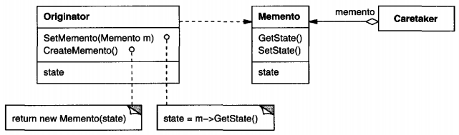
Implementation
Creates and stores states in Memento objects .
Contains state of an object to be restored.
Is responsible to restore object state from Memento

Slide 24
Code
Memento
public class Memento {
private String state;
public Memento(String state){
this.state = state;
}
public String getState(){
return state;
}
}

Slide 25
Code
Originator
public class Originator {
private String state;
public void setState(String state){
this.state = state;
}
public String getState(){
return state;
}
…

Slide 26
Code
Originator
…
public Memento saveStateToMemento(){
return new Memento(state);
}
public void getStateFromMemento(Memento
memento){
state = memento.getState();
}
}

Slide 27
Code
CareTaker
public class CareTaker {
private List<Memento> mementoList = new
ArrayList<Memento>();
public void add(Memento state){
mementoList.add(state);
}
public Memento get(int index){
return mementoList.get(index);
}
}

Slide 28
2.
Builder

Slide 29
What is this pattern?
The Builder is a design pattern designed to provide a flexible solution to various object creation problems in object-oriented programming.
The intent of the Builder design pattern is to separate the construction of a complex object from its representation

Slide 30
The problem is:
How can a class (the same construction process) create different representations of a complex object?
How can a class that includes creating a complex object be simplified?

Slide 31
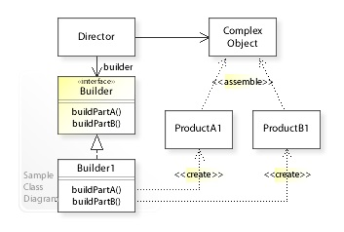
The solution is:
Encapsulate creating and assembling the parts of a complex object in a separate Builder object.
A class delegates object creation to a Builder object instead of creating the objects directly.

Slide 32
3.
Adapter

Slide 33

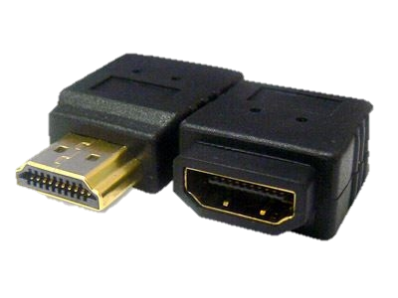

Adapter
What is the problem?
How adapter going to solve this problem?
Example code

Slide 34
4.
Observer

Slide 35
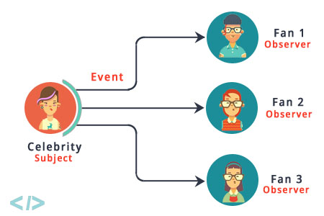
Observable
What is it?
Why we need this?
How implement it?

